Slide 1
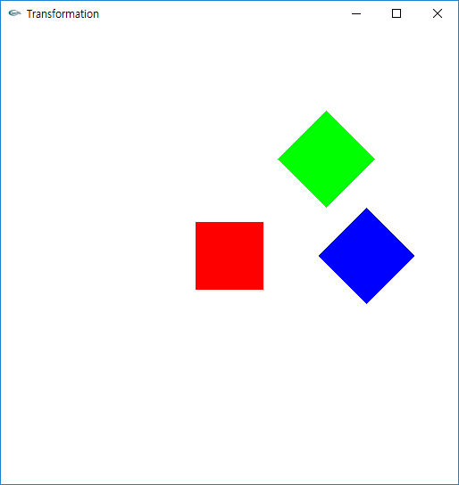
Geometric Transformation
디지털 그래픽스 [6주차]

Slide 2
Goals
Matrix Stack
glPushMatrix & glPopMatrix
Scale Matrix
Transformation by Keyboard

Slide 3
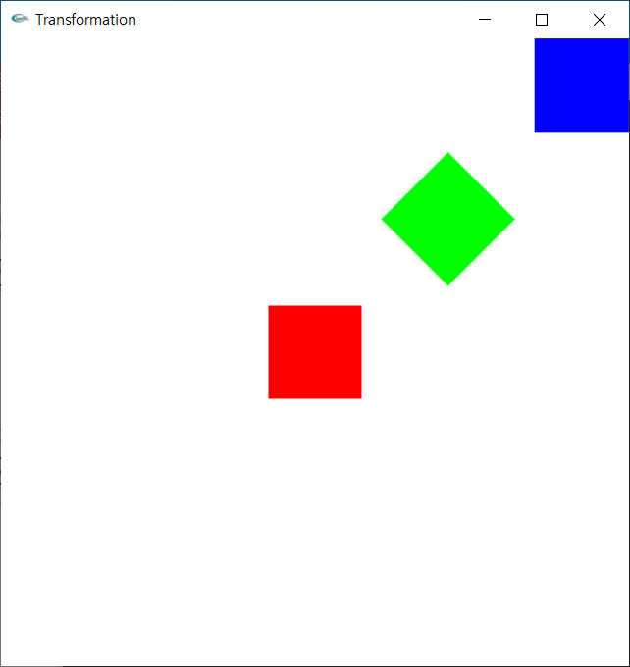
Transformation의 누적 현상
Transformation은 누적된다.
Inverse Transformation 사용으로 해결
<Transformation 누적>
<Inverse Transformation>
TR RT
TR T⁻¹R⁻¹ RT

Slide 4
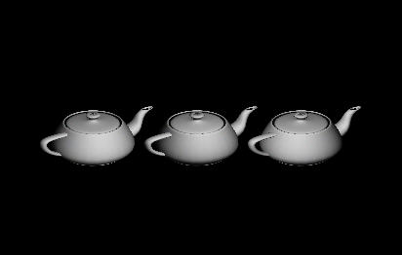
Transformation의 누적 현상
Three teapots
DrawTeapot();
glTranslate(1,0,0);
DrawTeapot();
glTranslate(-1,0,0);
DrawTeapot();
?
Left Teapot (-1, 0, 0)
First Teapot (0, 0, 0)
Right Teapot (1, 0, 0)

Slide 5
Matrix Multiplication 누적
동작 원리
Matrix Stack
Current Matrix: the top of matrix stack
모든 matrix 연산은 current matrix에 누적
DrawTeapot();
glTranslate(1,0,0);
DrawTeapot();
glTranslate(-1,0,0);
DrawTeapot();
current matrix에 적용
Third Teapot (-1, 0, 0)
First Teapot (0, 0, 0)
Second Teapot (1, 0, 0)
Matrix Stack
T(0,0,0)
Expectation
Matrix Stack
T(1,0,0)
current matrix에 적용
Matrix Stack
T(0,0,0)
First Teapot (0, 0, 0)
Second Teapot (1, 0, 0)
Third Teapot (0, 0, 0)
Result

Slide 6
glLoadIdentity()
OpenGL의 Transformation Matrix 초기화 필요
glLoadIdentity() 함수는 Transformation Matrix 초기화 수행
replace the current matrix with the identity matrix
DrawTeapot();
glTranslate(1,0,0);
DrawTeapot();
glLoadIdentity()
glTranslate(-1,0,0);
DrawTeapot();
current matrix에 적용
Matrix Stack
T(0,0,0)
Matrix Stack
current matrix에 적용
T(1,0,0)
Third Teapot (-1, 0, 0)
First Teapot (0, 0, 0)
Second Teapot (1, 0, 0)
Matrix Stack
T(0,0,0)
current matrix에 적용
Matrix Stack
T(-1,0,0)

Slide 7
Solar system
We can draw blue planets with loadIdentity()
DrawCircle();
glTranslate(0.6,0,0);
DrawCircle();
glLoadIdentity()
glTranslate(-0.6,0,0);
DrawCircle();
0.6

Slide 8
Solar system
We can't draw green planets with loadIdentity()
current matrix에 적용
0.6
DrawCircle();
glTranslate(0.6,0,0);
DrawCircle();
glLoadIdentity()
glTranslatef(-0.6,0,0);
DrawCircle();
glTranslate(-0.3,0,0);
DrawCircle();
How to do??
Matrix Stack
0.3
T(0,0,0)
T(0.6,0,0)
T(0,0,0)
T(-0.6,0,0)
다음 연산을 적용하기 전에,
현재 current Matrix 저장
T(-0.9,0,0)
왼쪽 green planet을
그린다
T(-0.6,0,0)
저장한 matrix를
Current matrix로 불러와서
T(0.3,0,0)
오른쪽 green planet을
그린다

Slide 9
Solar system
We can't draw green planets with loadIdentity()
current matrix에 적용
0.6
DrawCircle();
glTranslate(0.6,0,0);
DrawCircle();
glLoadIdentity()
glTranslatef(-0.6,0,0);
DrawCircle();
glTranslate(-0.3,0,0);
DrawCircle();
How to do??
Matrix Stack
0.3
T(0,0,0)
T(0.6,0,0)
T(0,0,0)
T(-0.6,0,0)
다음 연산을 적용하기 전에,
현재 current Matrix 저장
T(-0.6,0,0)
duplicate
T(-0.6,0,0)
T(-0.9,0,0)
delete
T(-0.6,0,0)
왼쪽 green planet을
그린다
T(-0.6,0,0)
저장한 matrix를
Current matrix로 불러와서
T(0.3,0,0)
오른쪽 green planet을
그린다

Slide 10
Solar system
We can't draw green planets with loadIdentity()
current matrix에 적용
0.6
DrawCircle();
glTranslate(0.6,0,0);
DrawCircle();
glLoadIdentity()
glTranslatef(-0.6,0,0);
DrawCircle();
Duplicate()
glTranslate(-0.3,0,0);
DrawCircle();
Delete()
glTranslate(0.3,0,0);
DrawCircle();
Matrix Stack
0.3
T(0,0,0)
T(0.6,0,0)
T(0,0,0)
T(-0.6,0,0)
다음 연산을 적용하기 전에,
현재 current Matrix 저장
T(-0.6,0,0)
duplicate
T(-0.6,0,0)
T(-0.9,0,0)
delete
T(-0.6,0,0)
왼쪽 green planet을
그린다
T(-0.6,0,0)
저장한 matrix를
Current matrix로 불러와서
T(0.3,0,0)
오른쪽 green planet을
그린다

Slide 11
Quiz. duplicate/delete (제출x)
Red, blue, green planets을 그리는 코드를 작성하세요.
0.4
0.1

Slide 12
Quiz1. duplicate/delete (제출o)
Red, blue, green and yellow planets을 그리는 코드를 작성하세요.
0.4
0.2
0.1

Slide 13
Goals
Matrix Stack
glPushMatrix & glPopMatrix
Scale Matrix
Transformation by Keyboard

Slide 14

glPushMatrix() / glPopMatrix()
Matrix Stack
T(-1,0,0)
duplicate
glPushMatrix()
pushes the current matrix stack down by one, duplicating the current matrix.
after a glPushMatrix call, the matrix on top of the stack is identical to the one below it.
glPopMatrix()
pops the current matrix stack, replacing the current matrix with the one below it on the stack.
T(1,0,0)
push
T(-1,0,0)
duplicate
T(-1,0,0)
delete
T(1,0,0)
pop
T(-1,0,0)
delete
T(-1,0,0)
T(1,0,0)

Slide 15
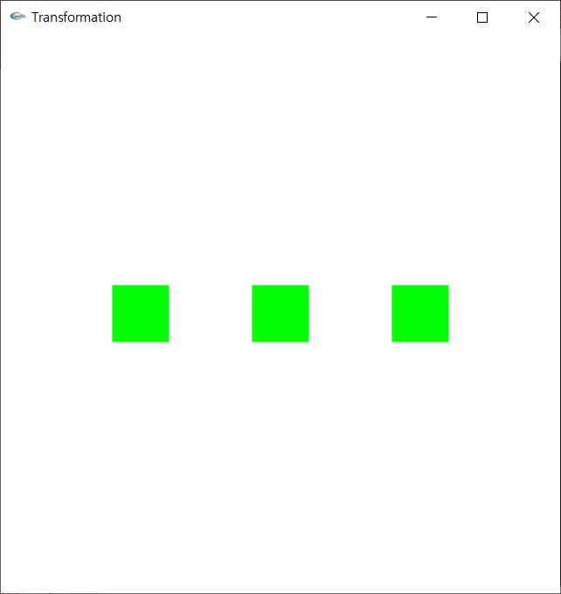
glPushMatrix() / glPopMatrix()
glLoadIdentity()로 대체 가능
DrawSquare();
glPushMatrix();
glTranslatef(-0.6f, 0.0f, 0.0f);
DrawSquare();
glPopMatrix();
glTranslatef(0.6f, 0.0f, 0.0f);
DrawSquare();
T(0,0,0)
T(0,0,0)
T(0,0,0)
T(-0.6,0,0)
T(0,0,0)
(2)
(1)
(3)
T(0,0,0)
T(0.6,0,0)

Slide 16
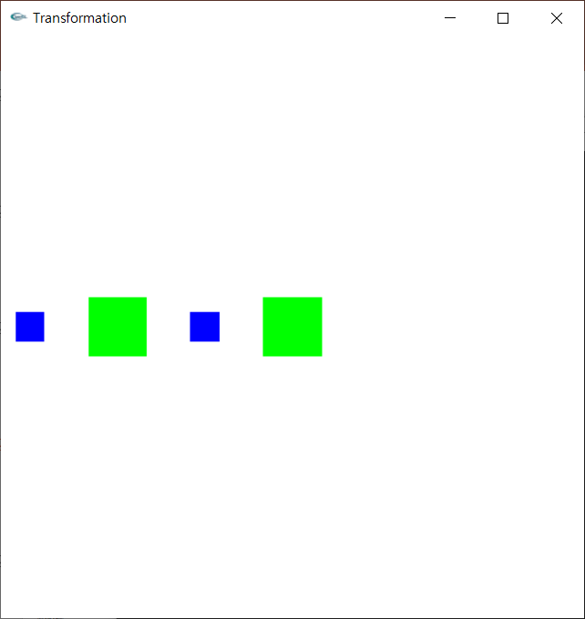
glPushMatrix() / glPopMatrix()
glLoadIdentity()로 해결이 안되는 경우
glClear(GL_COLOR_BUFFER_BIT | GL_DEPTH_BUFFER_BIT);
DrawSquare();
glTranslatef(-0.6f, 0.0f, 0.0f);
DrawSquare();
glPushMatrix();
glTranslatef(-0.3f, 0.0f, 0.0f);
DrawSquareSmall();
glPopMatrix();
glTranslatef(0.3f, 0.0f, 0.0f);
DrawSquareSmall();
기준선
기준선
T(0,0,0)
-0.3
0.3
T(-0.6,0,0)
-0.9
-0.6
-0.3
0
T(-0.6,0,0)
T(-0.6,0,0)
T(-0.9,0,0)
T(-0.6,0,0)
T(-0.6,0,0)
T(-0.3,0,0)

Slide 17
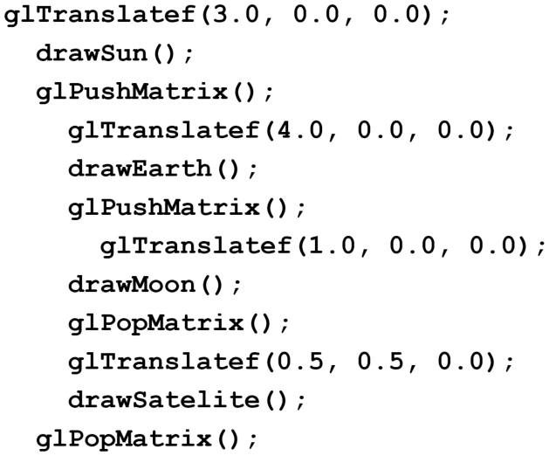
Coding Example. Solar System
3
4
Satellite
Sun
Earth
1
Moon
T(3,0,0)
T(3,0,0)
T(3,0,0)
T(7,0,0)
T(7,0,0)
T(3,0,0)
T(7,0,0)
T(8,0,0)
T(3,0,0)
T(7,0,0)
T(7,0,0)
T(3,0,0)
T(3,0,0)
T(7.5,0.5,0)
T(3,0,0)
T(3,0,0)

Slide 18
Quiz2. Satellite2를 그리는 코드 추가
Satellite2 는 Sun 에서 왼쪽으로 0.8 아래쪽으로 0.8 떨어져 있다.
3
4
Satellite1
Satellite2
Earth
Moon
Sun
1
T(3,0,0)
T(3,0,0)
T(3,0,0)
T(7,0,0)
T(7,0,0)
T(3,0,0)
T(7,0,0)
T(8,0,0)
T(3,0,0)
T(7,0,0)
T(7,0,0)
T(3,0,0)
T(3,0,0)
T(7.5,0.5,0)
T(3,0,0)
T(3,0,0)

Slide 19
Coding Example. Solar System
각 Sphere는 행성을 의미
각 행성은 공전과 자전을 수행
검정색 라인은 비행선이 움직인 궤도
Red Sun
Red Sun을 회전하는 Blue Earth
Blue Earth를 회전하는 green moon
어떻게 구현할 수 있을까?
glPushMatrix() / glPopMatrix() 이용
Animation 구현

Slide 20
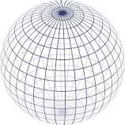
sphere
Usage
void glutSolidSphere(GLdouble radius, GLint slices, GLint stacks);
void glutWireSphere(GLdouble radius, GLint slices, GLint stacks);
radius
The radius of the sphere.
slices
The number of subdivisions around the Z axis (similar to lines of longitude).
stacks
The number of subdivisions along the Z axis (similar to lines of latitude).
Description
Renders a sphere centered at the modeling coordinates origin of the specified radius. The sphere is subdivided around the Z axis into slices and along the Z axis into stacks.

Slide 21
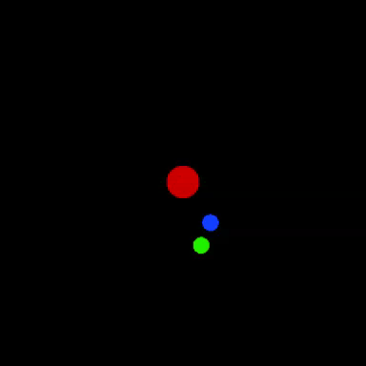
Solar System
void display(void)
{
glClear(GL_COLOR_BUFFER_BIT | GL_DEPTH_BUFFER_BIT);
glLoadIdentity();
glColor3f(1.0f, 0.0f, 0.0f); // red
glutSolidSphere(0.1f, 100, 100);
glPushMatrix();
glRotatef(blueAngle, 0.0f, 0.0f, 1.0f);
glTranslatef(0.6f, 0.0f, 0.0f);
glColor3f(0.0f, 0.0f, 1.0f); // blue
glutSolidSphere(0.05f, 100, 100);
glPushMatrix();
glRotatef(blueAngle, 0.0f, 0.0f, 1.0f);
glTranslatef(0.3f, 0.0f, 0.0f);
glColor3f(0.0f, 1.0f, 0.0f); // green
glutSolidSphere(0.05f, 100, 100);
glPopMatrix();
glPopMatrix();
blueAngle += 1.0f;
glFlush();
}
Red Sun
Red Sun을 회전하는blue Earth
Blue Earth를 회전하는
green moon
#include <gl/glut.h>
GLfloat blueAngle = 0.0f;
int main(int argc, char** argv)
{
glutInit(&argc, argv);
glutInitDisplayMode(GLUT_RGBA | GLUT_DEPTH | GLUT_SINGLE);
glutCreateWindow("Transformation");
glutDisplayFunc(display);
glutIdleFunc(display);
glutMainLoop();
return 0;
}

Slide 22
Solar System
void display(void)
{
glClear(GL_COLOR_BUFFER_BIT | GL_DEPTH_BUFFER_BIT);
glLoadIdentity();
glColor3f(1.0f, 0.0f, 0.0f); // red
glutSolidSphere(0.1f, 100, 100);
glPushMatrix();
glRotatef(blueAngle, 0.0f, 0.0f, 1.0f);
glTranslatef(0.6f, 0.0f, 0.0f);
glColor3f(0.0f, 0.0f, 1.0f); // blue
glutSolidSphere(0.05f, 100, 100);
glPushMatrix();
glRotatef(blueAngle, 0.0f, 0.0f, 1.0f);
glTranslatef(0.3f, 0.0f, 0.0f);
glColor3f(0.0f, 1.0f, 0.0f); // green
glutSolidSphere(0.05f, 100, 100);
glPopMatrix();
glPopMatrix();
blueAngle += 1.0f;
glFlush();
}
이 예제에서 glPushMatrix(), glPopMatrix() 함수를 반드시 사용해야 할까요?
NO!

Slide 23
Coding Example. Solar System
각 Sphere는 행성을 의미
각 행성은 공전과 자전을 수행
검정색 라인은 비행선이 움직인 궤도
Red Sun
Red Sun을 회전하는 Blue Earth
Blue Earth를 회전하는 green moon
Red Sun을 반시계 방향으로 회전하는 Yellow Satellite
이 예제에서 glPushMatrix(), glPopMatrix() 함수를 반드시 사용해야 할까요?
YES!

Slide 24
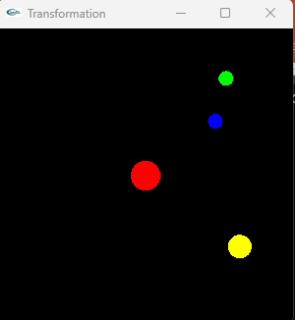
은하계를 여행하는 비행선
void display(void)
{
glClear(GL_COLOR_BUFFER_BIT | GL_DEPTH_BUFFER_BIT);
glLoadIdentity();
glColor3f(1.0f, 0.0f, 0.0f); // red
glutSolidSphere(0.1f, 100, 100);
glPushMatrix();
glRotatef(blueAngle, 0.0f, 0.0f, 1.0f);
glTranslatef(0.6f, 0.0f, 0.0f);
glColor3f(0.0f, 0.0f, 1.0f); // blue
glutSolidSphere(0.05f, 100, 100);
glPushMatrix();
glRotatef(blueAngle, 0.0f, 0.0f, 1.0f);
glTranslatef(0.3f, 0.0f, 0.0f);
glColor3f(0.0f, 1.0f, 0.0f); // green
glutSolidSphere(0.05f, 100, 100);
glPopMatrix();
glPopMatrix();
glRotatef(1-blueAngle, 0.0f, 0.0f, 1.0f);
glTranslatef(0.8f, 0.0f, 0.0f);
glColor3f(1.0f, 1.0f, 0.0f); // yellow
glutSolidSphere(0.08f, 100, 100);
blueAngle += 1.0f;
if (blueAngle == 360) blueAngle = 0;
glFlush();
}

Slide 25
Quiz2. Solar System
이전 슬라이드에 있는 코드에 pink satellite의 회전을 추가하세요.
각 Sphere는 행성을 의미
각 행성은 공전과 자전을 수행
검정색 라인은 비행선이 움직인 궤도
Red Sun
Red Sun을 회전하는 Blue Earth
Blue Earth를 회전하는 green moon
Red Sun을 반시계 방향으로 회전하는 Yellow Satellite
Yellow satellite를 회전하는 pink satellite
* 방향을 표기하지 않으면, default 시계 방향 회전

Slide 26
Quiz3. Solar System
void display(void)
{
glClear(GL_COLOR_BUFFER_BIT | GL_DEPTH_BUFFER_BIT);
glLoadIdentity();
glColor3f(1.0f, 0.0f, 0.0f); // red
glutSolidSphere(0.1f, 100, 100);
glPushMatrix();
glRotatef(blueAngle, 0.0f, 0.0f, 1.0f);
glTranslatef(0.6f, 0.0f, 0.0f);
glColor3f(0.0f, 0.0f, 1.0f); // blue
glutSolidSphere(0.05f, 100, 100);
glPushMatrix();
glRotatef(blueAngle, 0.0f, 0.0f, 1.0f);
glTranslatef(0.3f, 0.0f, 0.0f);
glColor3f(0.0f, 1.0f, 0.0f); // green
glutSolidSphere(0.05f, 100, 100);
glPopMatrix();
glPopMatrix();
glRotatef(1-blueAngle, 0.0f, 0.0f, 1.0f);
glTranslatef(0.8f, 0.0f, 0.0f);
glColor3f(1.0f, 1.0f, 0.0f); // yellow
glutSolidSphere(0.08f, 100, 100);
blueAngle += 1.0f;
if (blueAngle == 360) blueAngle = 0;
glFlush();
}
이전 슬라이드에 있는 코드에 pink satellite를 추가하세요.
회전 없이
태양, 지구, 달, 위성을 고정 위치에 그리세요

Slide 27
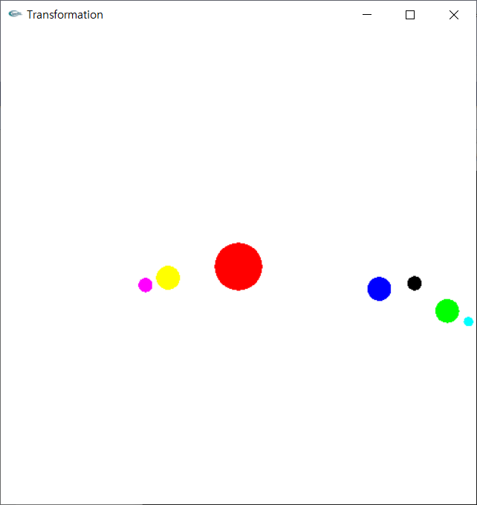
과제 1. Matrix Stack
아래 애니메이션을 구현하세요. (포탈 <강의자료>에 동영상 파일 첨부)
기존 코드
Red Sun
Red Sun을 회전하는 Blue Earth
Blue Earth를 회전하는 green moon
신규 코드 작성
Red Sun을 회전하는 Yellow satellite
Yellow satellite를 회전하는 pink satellite
Blue Earth를 회전하는 또 다른 black satellite
Green Moon을 회전하는 sky satellite

Slide 28
Goals
Matrix Stack
glPushMatrix & glPopMatrix
Scale Matrix
Transformation by Keyboard

Slide 29
3D Scale Matrix
glScalef(x, y, z)
Not just for a size
Also for a position, which is a distance from the origin
y
x
z
x’ = S_{x}*x + 0*y + 0*z + 0*1
x’ = S_{x}*x

Slide 30
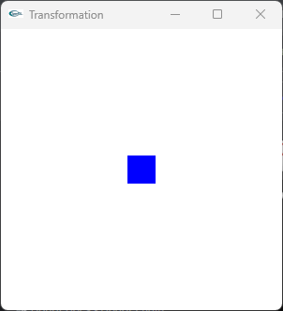
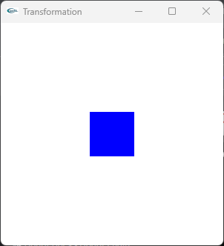
Scaling
물체의 중심이 원점에 있을 때 scaling
glScalef(2.0, 2.0, 0.0)
glutSolidCube(0.2)
(-0.1, 0.1)
(0.1, 0.1)
(-0.2, 0.2)
(0.2, 0.2)
(-0.1, -0.1)
(0.1, -0.1)
(-0.2, -0.2)
(0.2, -0.2)

Slide 31
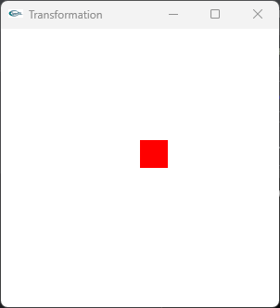
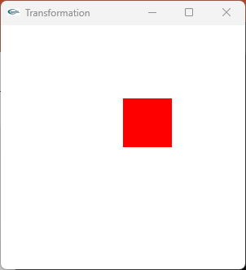
Scaling
물체의 vertex가 원점에 있을 때, scaling
glTranslatef(0.1, 0.1, 0.0)
glutSolidCube(0.2)
glScalef(2.0, 2.0, 0.0)
(0.0, 0.4)
(0.4, 0.4)
(0.0, 0.2)
(0.2, 0.2)
(0.0, 0.0)
(0.2, 0.0)
(0.0, 0.0)
(0.4, 0.0)

Slide 32
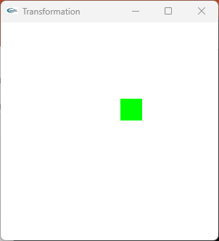
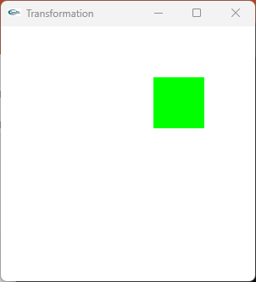
Scaling
물체가 원점에 있지 않을 때, scaling
glTranslatef(0.2, 0.2, 0.0)
glutSolidCube(0.2)
glScalef(2.0, 2.0, 0.0)
(0.2, 0.6)
(0.6, 0.6)
(0.1, 0.3)
(0.3, 0.3)
(0.2, 0.2)
(0.6, 0.2)
(0.1, 0.1)
(0.3, 0.1)

Slide 33
Fixed-point Scaling
y
y
y
y
F
z
x
z
x
z
x
z
x
Original Position
Translation
Scaling
Inverse Translation

Slide 34
Goals
Matrix Stack
glPushMatrix & glPopMatrix
Scale Matrix
Transformation by Keyboard

Slide 35
키보드 제어
glutKeyboardFunc(..)
sets the keyboard callback for the current window.
Usage
void glutKeyboardFunc(void (*func)(unsigned char key,
int x,
int y));
func : The new keyboard callback function.
Coding example
<키보드 콜백 함수>를 등록하는 함수
키보드 콜백함수명
<키보드 콜백 함수>의 매개변수 3개
void keyboard(unsigned char key, int x, int y)
{
}
glutKeyboardFunc( keyboard );

Slide 36
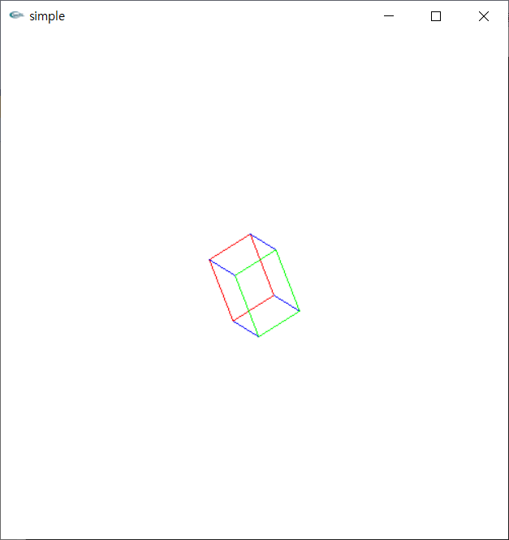
Transformation by Keyboard
Coding example
drawBox()
cube 그리기
display()
기본 변환
drawBox()
xyzRotate()
X축 기준 회전
glRotatef()
keyboard()
키보드 처리
glutPostRedisplay()
main()
display 콜백함수 등록
keyboard 콜백함수 등록
키보드 x 누르면 x축 기준 회전
키보드 y 누르면 y축 기준 회전
키보드 z 누르면 z축 기준 회전
키보드 s 누르면 확대
키보드 a 누르면 축소
키보드 t 누르면 오른쪽으로 이동
키보드 r 누르면 왼쪽으로 이동

Slide 37
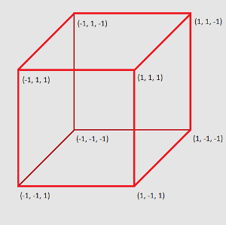
Transformation by Keyboard
(4)
(3)
#include <iostream>
#include <gl/glut.h>
#include <math.h> //sin(),cos()
using namespace std;
#define PI 3.141592
void drawBox()
{
// Red rectangle
glColor3f(1.0, 0.0, 0.0);
glBegin(GL_LINE_LOOP);
glVertex3f(-1.0, -1.0, -1.0);
glVertex3f( 1.0, -1.0, -1.0);
glVertex3f( 1.0, 1.0, -1.0);
glVertex3f(-1.0, 1.0, -1.0);
glEnd();
// Green rectangle
glColor3f(0.0, 1.0, 0.0);
glBegin(GL_LINE_LOOP);
glVertex3f(-1.0, -1.0, 1.0);
glVertex3f( 1.0, -1.0, 1.0);
glVertex3f( 1.0, 1.0, 1.0);
glVertex3f(-1.0, 1.0, 1.0);
glEnd();
// Blue lines
glColor3f(0.0, 0.0, 1.0);
glBegin(GL_LINES);
glVertex3f(-1.0, -1.0, -1.0);
glVertex3f(-1.0, -1.0, 1.0);
glVertex3f( 1.0, -1.0, -1.0);
glVertex3f( 1.0, -1.0, 1.0);
glVertex3f( 1.0, 1.0, -1.0);
glVertex3f( 1.0, 1.0, 1.0);
glVertex3f(-1.0, 1.0, -1.0);
glVertex3f(-1.0, 1.0, 1.0);
glEnd();
}
void display(void)
{
glClear(GL_COLOR_BUFFER_BIT | GL_DEPTH_BUFFER_BIT);
//glLoadIdentity();
glPushMatrix(); // initial setup: no accumulation
glRotatef(45.0, 1.0, 1.0, 1.0); // rotation w.r.t v=(1,1,1)
glScalef(0.1, 0.2, 0.1);
drawBox();
glPopMatrix();
glFlush();
}
(1)
(2)

Slide 38
Transformation by Keyboard
void xyzRotate(char mode)
{
switch (mode) {
case 'x': glRotatef(PI, 1, 0, 0); break;
case 'y': glRotatef(PI, 0, 1, 0); break;
case 'z': glRotatef(PI, 0, 0, 1); break;
default: break;
}
}
void keyboard(unsigned char key, int x, int y)
{
switch (key)
{
case 'x': xyzRotate('x'); glutPostRedisplay(); break;
case 'y': xyzRotate('y'); glutPostRedisplay(); break;
case 'z': xyzRotate('z'); glutPostRedisplay(); break;
default: break;
}
}
glutPostRedisplay()
display event 발생
display 콜백함수를 의도적으로 호출

Slide 39
Transformation by Keyboard
int main(int argc, char** argv)
{
glutInit(&argc, argv);
glutInitDisplayMode(GLUT_RGBA | GLUT_DEPTH | GLUT_SINGLE);
glutCreateWindow("Transformation");
// Set Background Color
glClearColor(1.0, 1.0, 1.0, 0.0);
glutDisplayFunc(display);
glutKeyboardFunc(keyboard);
glutMainLoop();
return 0;
}

Slide 40
과제 2. Transformation by Keyboard
주어진 코드에 그린색 기능을 추가하세요.
drawBox()
cube 그리기
display()
기본 변환
drawBox()
xyzRotate()
X축 기준 회전
glRotatef()
keyboard()
키보드 처리
glutPostRedisplay()
main()
display 콜백함수 등록
keyboard 콜백함수 등록
키보드 x 누르면 x축 기준 회전
키보드 y 누르면 y축 기준 회전
키보드 z 누르면 z축 기준 회전
키보드 s 누르면 확대
키보드 a 누르면 축소
키보드 t 누르면 오른쪽으로 이동
키보드 r 누르면 왼쪽으로 이동

Slide 41
Thank you !

